Slide 1


Slide 2


S.K. DENTAL CLINIC WEBSITE
Second Year Project Synopsis Presentation
Submitted by
ROLL NO. | NAME
2401011487 | Rounit Kumar
2401011485 | Prince Kumar Gupta
2401011483 | Naman Bharadwaj
2401012482 | Shantna Kumar
Industry Mentor: Dr. Kusum Mehta
Faculty Mentor: Dr. Ravinder Beniwal
Notes:
New Courses replaced with New Programmes

Slide 3

Project Overview
The S.K. Dental Clinic Website is an online platform designed to provide patients with easy access to dental care services. The website serves as a digital interface for the clinic, offering key features such as online appointment booking, service details, patient testimonials, and contact information.
This project aims to enhance patient engagement and streamline clinic operations by offering a user-friendly interface with an intuitive design. The website will also provide information about dental treatments, doctor availability, and emergency contact options, ensuring a seamless experience for both new and existing patients.
By integrating modern web technologies, the S.K. Dental Clinic Website will improve accessibility, efficiency, and communication between patients and the clinic staff, ultimately enhancing the overall healthcare experience.
Notes:
New Courses replaced with New Programmes

Slide 4
About the Problem
Problems Identified :-
Lack of Online Presence – Patients face difficulty in accessing clinic information, services, and contact details.
Manual Appointment Booking – Patients have to visit or call the clinic to book appointments, leading to inconvenience and mismanagement.
Limited Patient Engagement – No proper communication channel for sharing treatment details, dental care tips, or follow-up reminders.
Inefficient Record Management – Patient records and history are maintained manually, increasing the risk of errors and data loss.
No Emergency Assistance – Patients lack immediate access to emergency dental care or quick consultation options.
Notes:
New Courses replaced with New Programmes

Slide 5
About the Problem
Need for a Solution :-
To create an efficient and user-friendly online platform for the S.K. Dental Clinic.
To provide 24/7 accessibility to clinic services, appointment booking, and patient inquiries.
To improve patient experience through digital records, automated appointment reminders, and treatment guidelines.
To enhance clinic operational efficiency by reducing manual work and optimizing scheduling.
Notes:
New Courses replaced with New Programmes

Slide 6
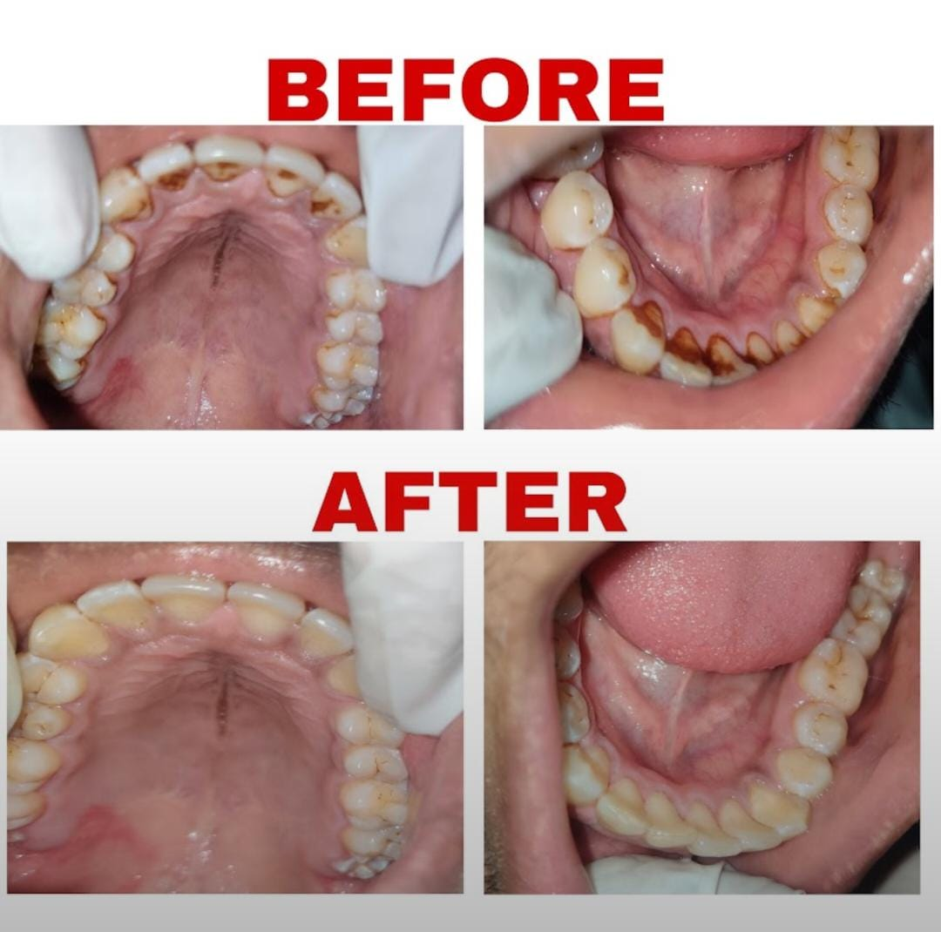
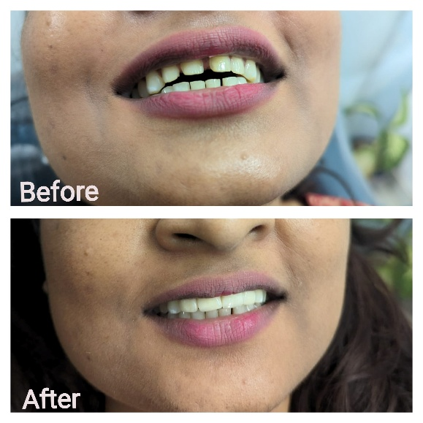
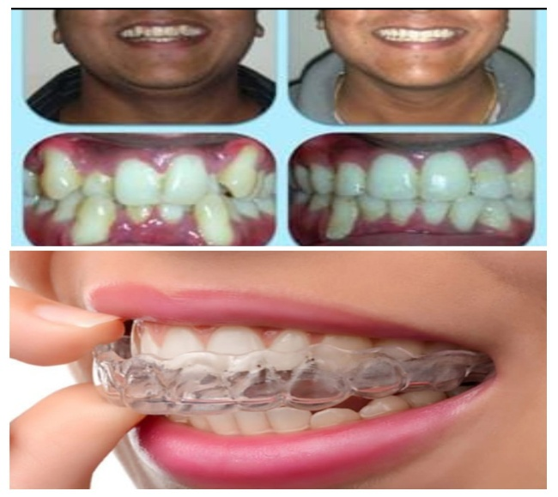
Before & After Gallery: Real Results
Notes:
New Courses replaced with New Programmes

Slide 7
Blog: Expert Dental Advice & Tips
Whitening:-Safe methods for a brighter smile.
Prevention:-How to avoid gum disease and cavities.
Oral Hygiene:-Tips on brushing and flossing techniques.
Notes:
New Courses replaced with New Programmes

Slide 8
Problem Statement
The S.K. Dental Clinic currently lacks an efficient online platform for managing appointments, patient records, and communication. The absence of a digital system leads to manual booking inefficiencies, difficulty in accessing clinic information, poor patient engagement, and data mismanagement.
Why is it Important ?
Improves Patient Convenience – Allows easy online appointment booking and access to treatment details.
Enhances Clinic Efficiency – Reduces manual workload and streamlines scheduling.
Ensures Better Patient Care – Provides timely reminders, follow-ups, and emergency contact options.
Minimizes Data Errors – Digital record-keeping ensures accurate patient history management.
Impact of Solving This Problem :-
Increased Patient Satisfaction – Faster and more convenient services.
Better Time Management – Reduces wait times and improves clinic operations.
Enhanced Accessibility – Patients can access information anytime, anywhere.
Stronger Patient-Doctor Relationship – Improved communication and engagement.
Developing the S.K. Dental Clinic Website will revolutionize clinic operations, making dental care more accessible, efficient, and patient-friendly.
Notes:
New Courses replaced with New Programmes

Slide 9
Methodology and Approach
Methodology:-
Designed a responsive website with an intuitive user interface for easy navigation.
Integrated an online appointment booking system to streamline scheduling.
Developed a secure patient record management system for efficient data handling.
Implemented automated notifications for appointment reminders and follow-ups.
Back-End Development
Technologies Used:
HTML: Structured the content of the web pages.
CSS: Styled the user interface to ensure a clean and professional look.
JavaScript: Added interactivity for dynamic content and smooth user experience.
Bootstrap: Used for a mobile-friendly and responsive design, ensuring compatibility across devices.
Design Principles Followed:
User-Centric Design: Focused on ease of use for both patients and clinic staff.
Responsive Layout: Ensured the site adapts to mobile, tablet, and desktop views.
Intuitive Navigation: Streamlined menus and booking flows for quick access.
Accessibility: Designed with clear fonts, colors, and labels for all users.
Notes:
New Courses replaced with New Programmes

Slide 10
Methodology and Approach
Back-End Development
Technologies Used:
Node.js: Provided the runtime environment for server-side operations.
Express.js: Managed routing, middleware, and request/response handling.
Database:
MongoDB: A database used for securely storing patient data and appointment records.
Server-Side Logic:
Handled appointment scheduling, data validation, and patient record management.
Implemented automated email/SMS notifications for reminders and follow-ups.
Ensured secure data handling with encrypted storage and proper authentication.
Notes:
New Courses replaced with New Programmes

Slide 11
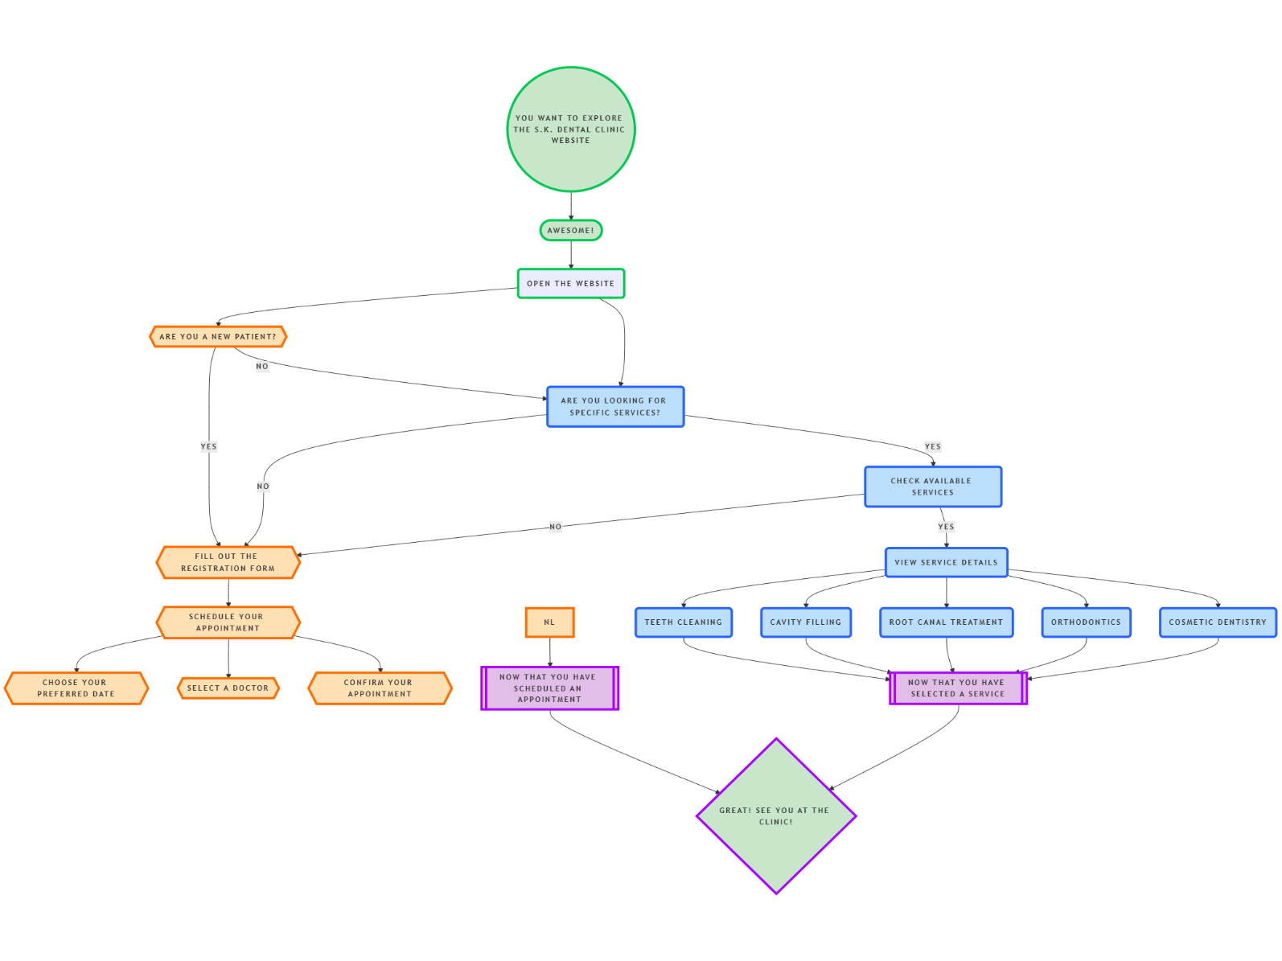
Flowchart Of S.K. Dental Clinic
Notes:
New Courses replaced with New Programmes

Slide 12
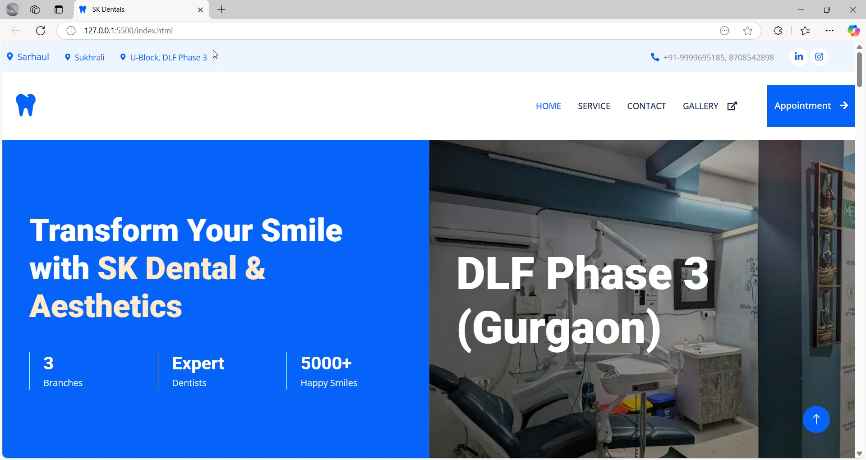
Demonstration
Notes:
New Courses replaced with New Programmes

Slide 13
Conclusion
Learning And Experience :-
Through this project, I gained valuable experience in designing and developing a responsive, user-friendly website tailored to real-world healthcare needs. I learned how to identify key problems—such as lack of online access, inefficient appointment systems, and poor patient engagement—and address them using modern web technologies. I became proficient in tools like HTML, CSS, JavaScript, Node.js, Express.js, and MongoDB, and also practiced deploying a live website using Netlify. The project deepened my understanding of full-stack development, user experience design, and how digital solutions can enhance service delivery in the medical field
Future Improvements :-
For future enhancements, plan to:
Integrate Payment Gateways for online consultation fees.
Add Teleconsultation Features using video call APIs.
Include a Chatbot for instant support and FAQs.
Enhance Security through advanced data encryption and user authentication.
Develop a Mobile App version for easier access.
Implement Analytics for appointment trends and patient feedback
Notes:
New Courses replaced with New Programmes

Slide 14
THANK YOU!

